Slide 1
Connected Device Studio Skill Transfer
Service Bus, OpsInfra, OpsAlarm
Andy Li

Slide 2
Outline
Overview
Service Bus
Queues
Topics
OpsInfra
OpsAlarm

Slide 3
Overview

Slide 4
Whole View
Service Bus
3. Log data
7. Submit Task
8. Submit Task
21. Submit Alarm Message
Azure
Storage
4. Log data
Super Admin
Web MVC
Admin
Web MVC
22. Initial / HA / Log
Initial
Redis Cache
20. RT Message
23. Auth
….
2. Data Cache
Admin
API
Device
API
Device
Mgt
24. D2C Message
Azure SQL
1. Entity Framework
25. DM
….
Restful API
27. Alarm Message
5. Log data
6. Image File
26. C2D Message
Azure
Storage
13. Heartbeat
17. D2C Message
IoT Hub
IoT Device
/ GW SDK
SB Client
Alarm Ops
SB Client
Infra Ops
Routine Task
IoT Hub
Receiver
28. Call Ext App.
Backend Services (Service Fabric)
18. C2D Message
19. Device Management
External Applications
9. Consume Task
10. Consume Task
12. Consume Task
11. Get Doc Usage.
15. Create DB
16. Store Message
14. Task Update
Service Bus
Document
DB
Azure SQL

Slide 5






Service Architecture
Blob Storage
OpsInfra : handle the deployment of cloud service
OpsAlarm : processing the alarm message and communicate with external application
Service Bus : make services communication easier
Service Fabric : host OpsInfra, OpsAlarm and other backend process.
Azure SQL: Backend process access company, usageLog and other business entities.
IoT Hub: cloud to device command
Document DB: backend process read/write telemetry and alarm message.
SuperAdmin/Admin Web : show backend process healthy and real time dashboard
Service Fabric
Admin Web
Virtual
machine
Azure SQL
Service Bus
Virtual
machine
Document DB
Super Admin
Virtual
machine
IoT Hub
SuperAdmin / Admin Web

Slide 6
Service Bus

Slide 7
Queue and Topic
S
R
Queue
R
R
S
Topic
Sub
R
Sub
Sub
R
R
Notes:
The subscriptions can use additional filters to restrict the messages that they want to receive Azure中繼服務通過使您能夠將公司企業網絡內的服務安全地公開到公有云，而無需打開防火牆連接，或需要對公司網絡基礎架構進行內部更改，從而便於混合應用程序

Slide 8
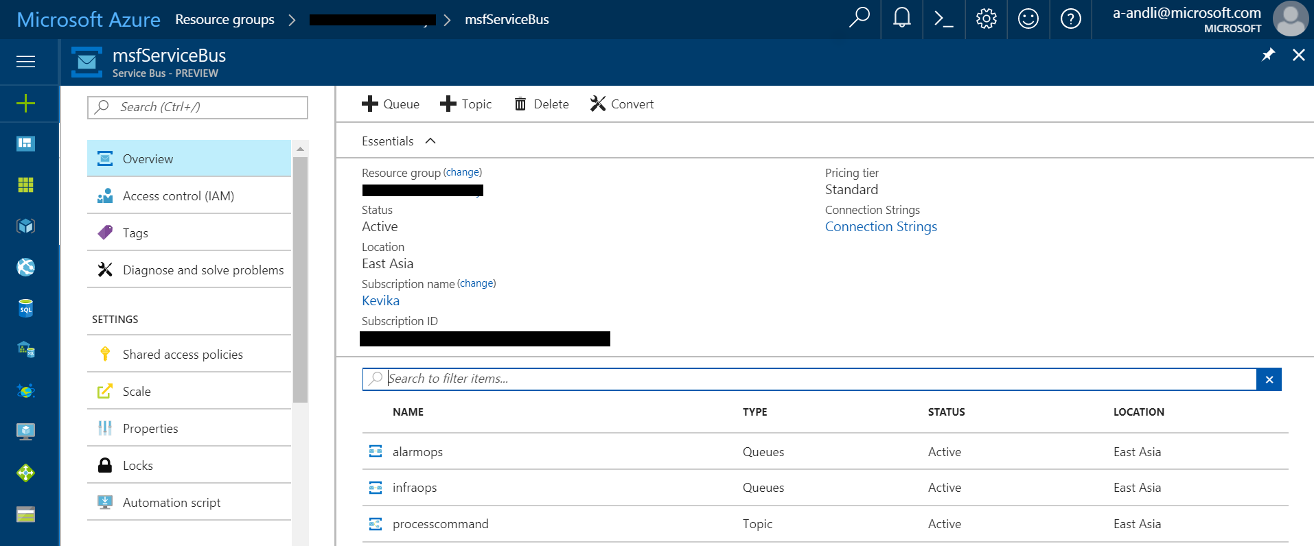
Azure Portal

Slide 9
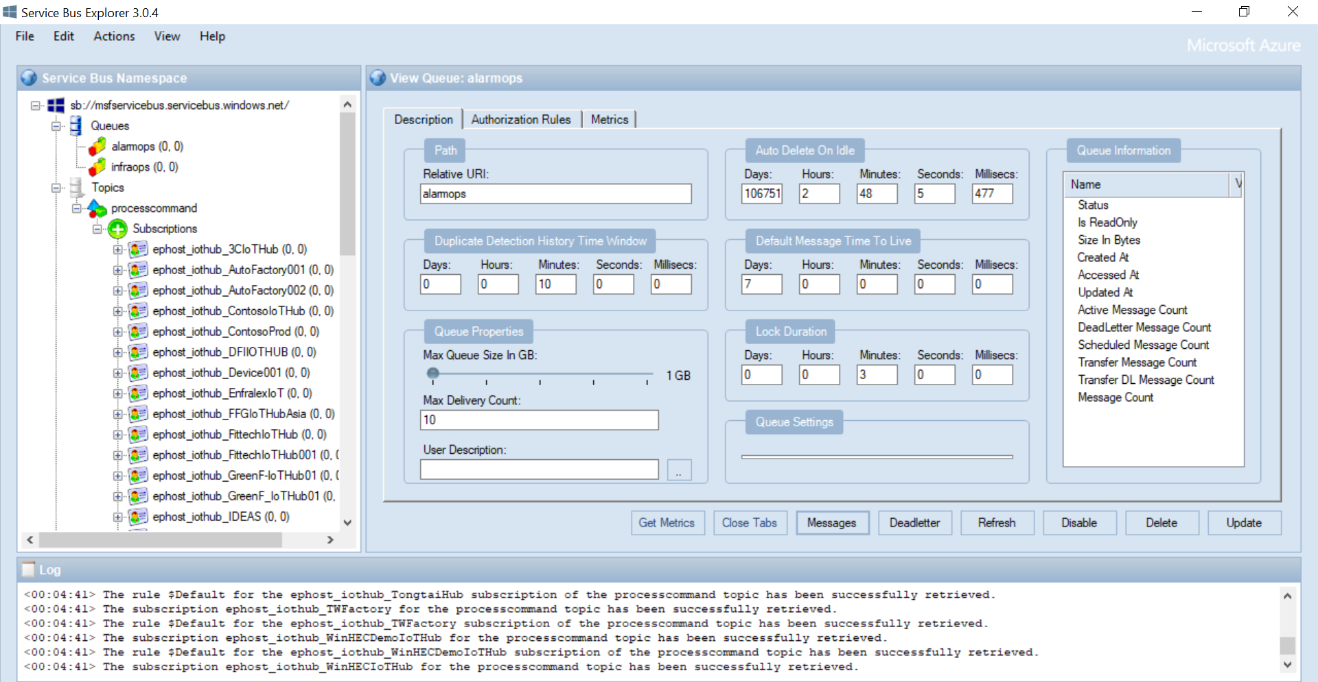
Service Bus Explorer
https://code.msdn.microsoft.com/Service-Bus-Explorer-f2abca5a

Slide 10
OpsAlarm

Slide 11



Code Architecture
Service Bus
alarmops (Queue)
Infraops (Queue)
processcommand (Topic)
Listen and retrieve message
Service Fabric
OpsAlarm
OpsInfra
IoT Hub Receiver
Routine Task
Exception
Query data
DocumentDB
Helper
Log
Utility
DB
Helper
Message processing
Share Library
Exception, Container : log-backend-opsalarm
Entity Framework
External Application
External API
Admin
IoT Device
IoT Hub
Document DB
Azure Storage
log-backend-opsalarm
SQL Database

Slide 12
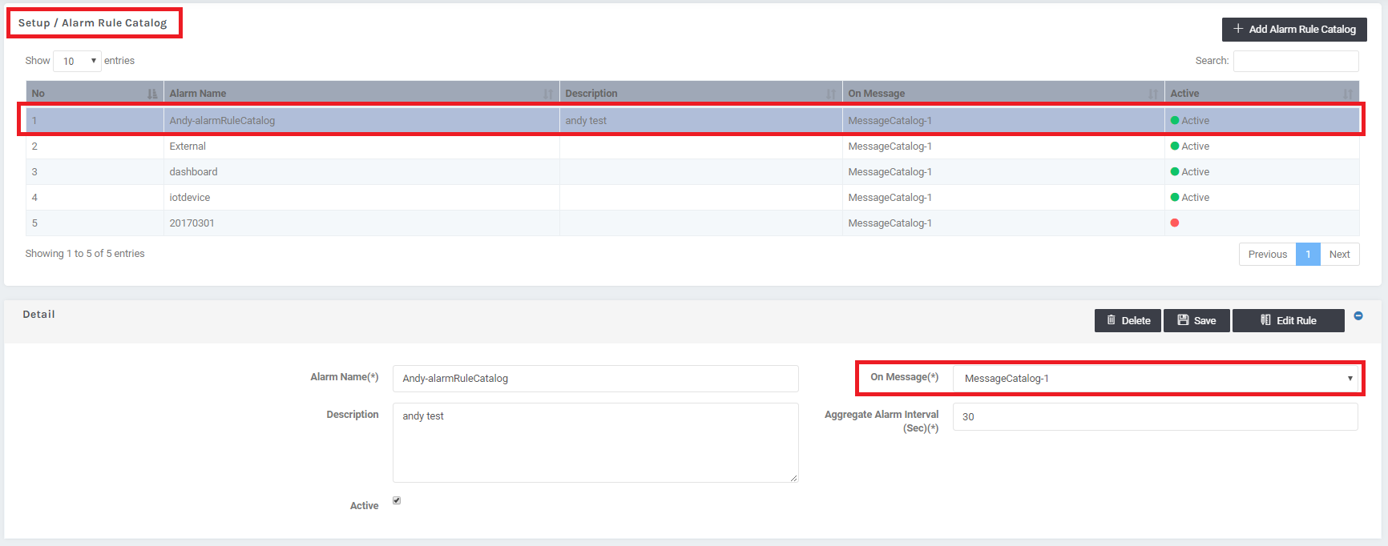
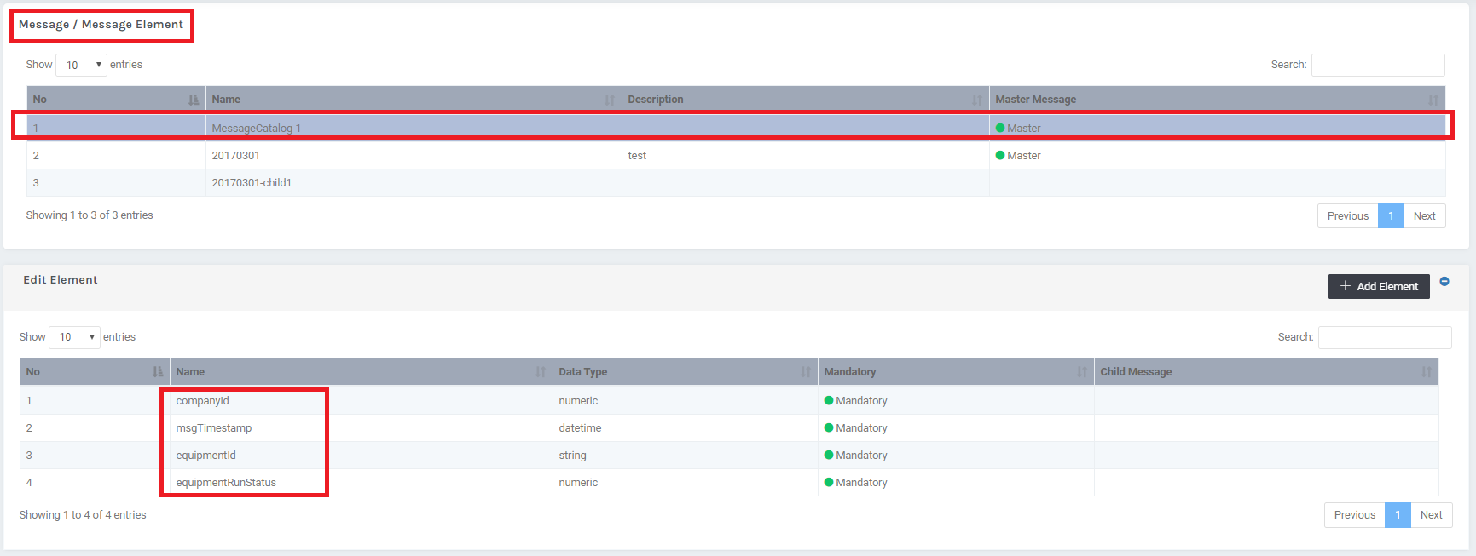
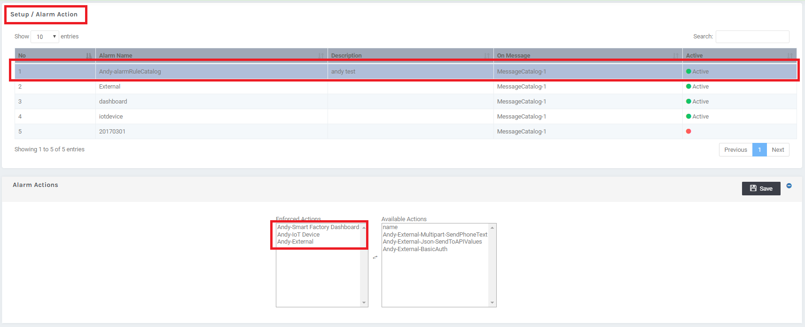
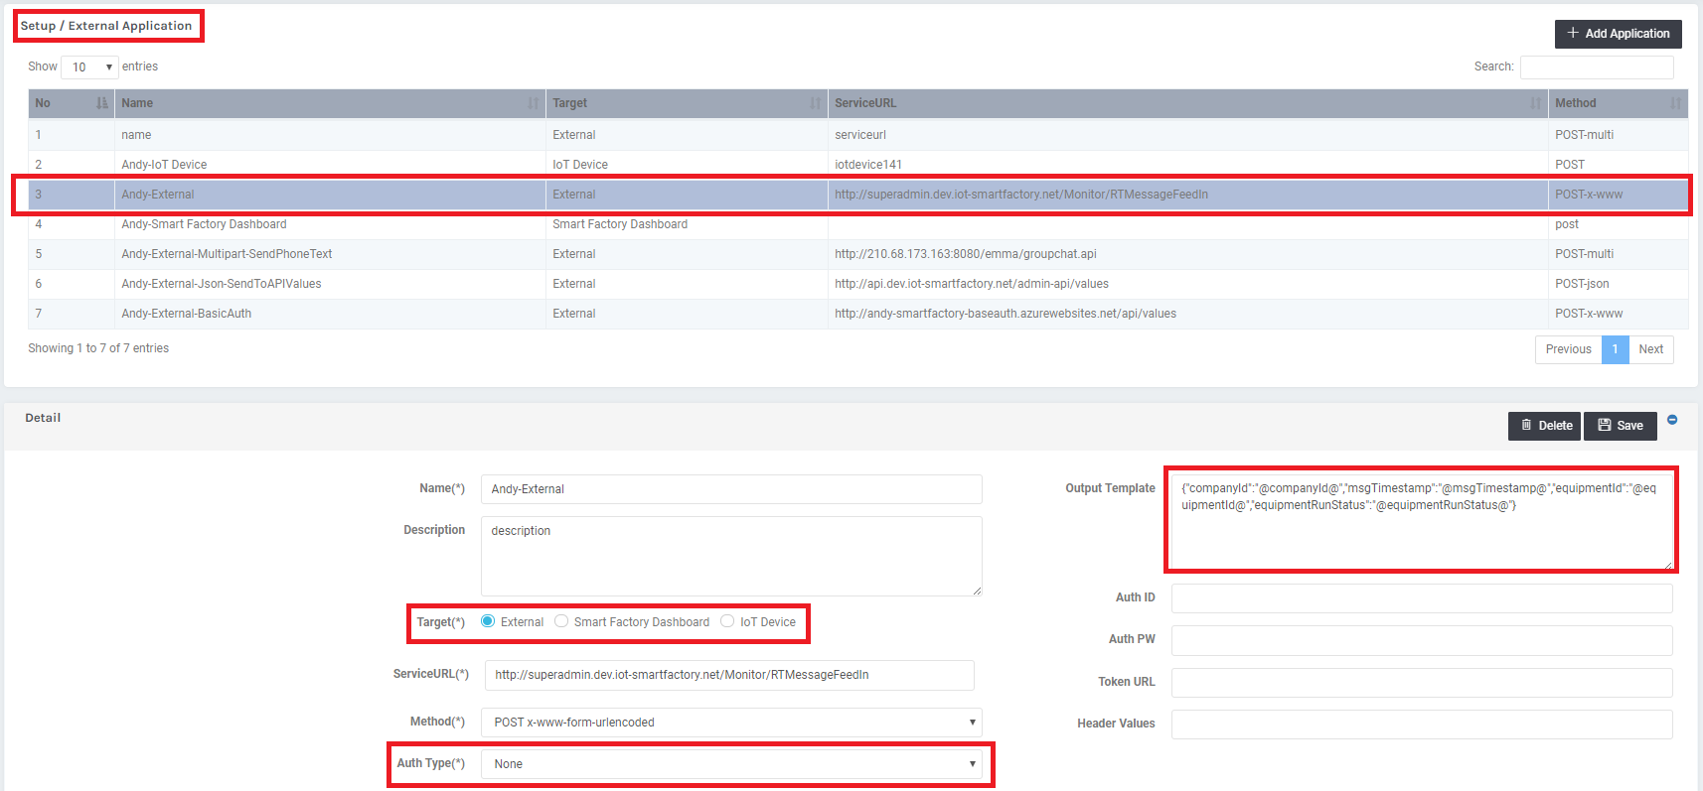

Slide 13
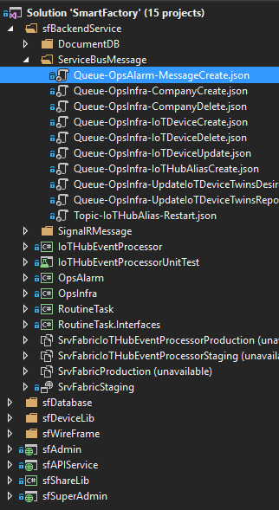
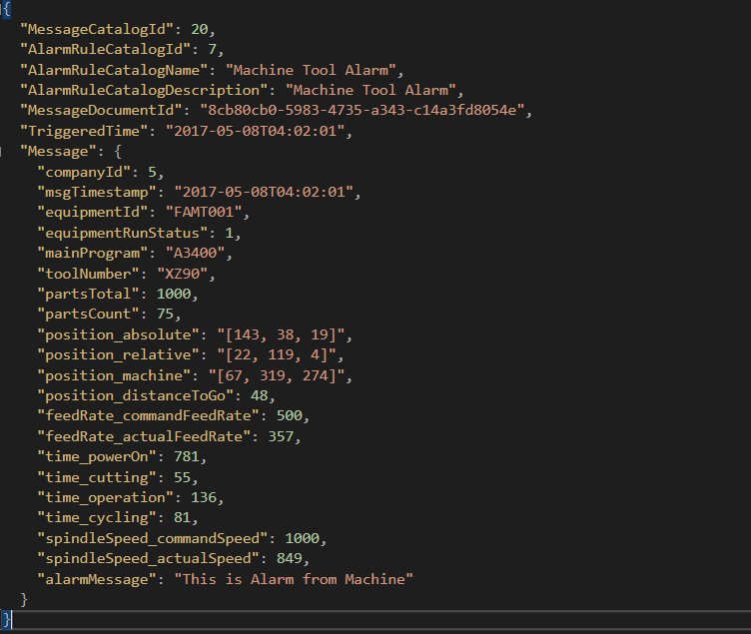
Message Format – In Service Bus (opsalarm)

Slide 14
Call Flow
Push to dash board
6
OpsAlarm
IoTHubReceiver
admin web
AlarmtoApplicationHelper.cs
5
1
Switch external application type
Send alarm message
Cloud to device command
6
IoT Hub
4
Parsing output msg template
Get alarm’s external applications from SQL DB
7
3
Parsing message
IoTDevice
Program.cs
Post to external API
alarmops (Queue)
2
Listen alarmops
External API
Content-Type
multipart/form-data
application/x-www-form-urlencoded
application/json
Auth : Basic Auth or none
Send Heart beat
admin web
Notes:
Left down super admin
IoTDevice -> IoTHub

Slide 15
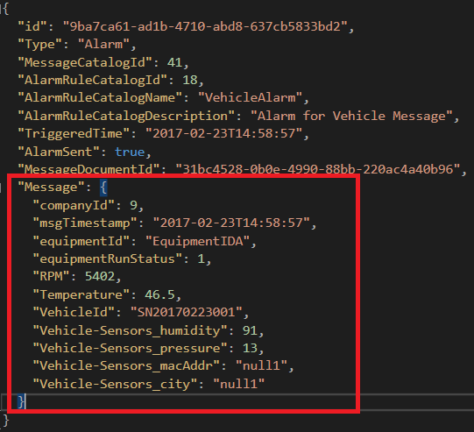
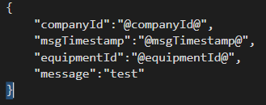
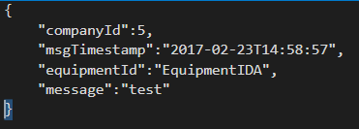
Message Output Process
Output Template
Message Content
Message Output

Slide 16
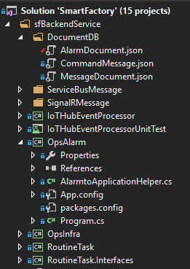
File Architecture
OpsAlarm
AlarmtoApplicationHelper.cs
Switch external application type
Parsing Output template
Get alarm’s external applications from SQL DB
Parsing message
Program.cs
Listen alarmops
Send Heart beat

Slide 17
OpsInfra

Slide 18
Code Architecture
Service Bus
alarmops (Queue)
Infraops (Queue)
processcommand (Topic)
Listen and retrieve message
Service Fabric
OpsAlarm
OpsInfra
IoT Hub Receiver
Routine Task
launch/remove IoTHubReceiver
create/update/remove IoTDevice settings on IoTHub
Exception
Exception, Container : log-backend-opsalarm
Share Library
DocumentDB
Helper
Log
Utility
DB
Helper
Create/remove collection and database under specific DocumentDB
Entity Framework
External Application
External API
Admin
IoT Device
IoT Hub
Document DB
Azure Storage
log-backend-opsinfra
SQL Database

Slide 19
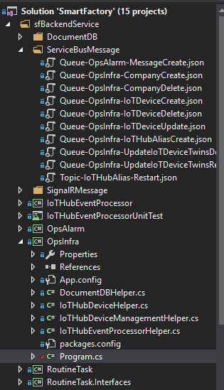
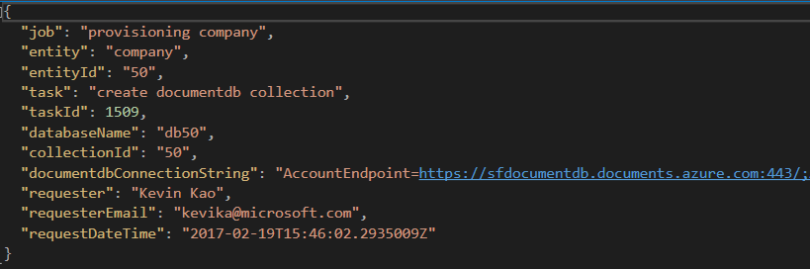
Example of Message format - provisioning company

Slide 20
Call Flow
Send message
1
2
Create new operation task
1
admin web
2
Infraops (Queue)
super admin
web
5
OpsInfra
Program.cs
3
Switch command
Listen Infraops
Send Heart beat
Update Task Status
4
create documentdb collection
purge documentdb collection
create iothub alias
remove iothub alias
create iothub register
update iothub register
remove iothub register
DocumentDBHepler.cs
IoTHubEventProcessorHepler.cs
Database Settings
Name : companyId
Collection Settings
Name : companyId
Partition Keys : /Message/equipmentId
Throughput : 400 RU/s
Indexing policy : Lazy
Parameter
Name : fabric:/IoTHubEP_ + IoTHubAlias
InstanceCount : 1
IoTHubDeviceHepler.cs
IoT Device Authentication
Key
X509
5
5
Create
Remove
5
5
5
5
Calling service fabric API
Credential
Create
Purge
Create
5
Update
Remove
Delete device both in primary
and secondary IoTHub
create device both in primary
and secondary IoTHub
1
2
Container : srvfabric
IoTHubAlias1
IoTHubAlias2
Create
Reave
primary
secondary
primary
secondary
IoTHubReceiver 1

Slide 21
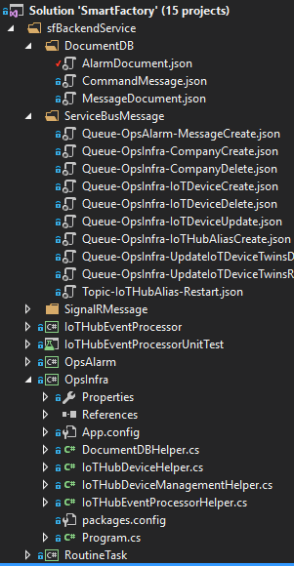
File Architecture
Program.cs
Switch command
Listen Infraops
Send Heart beat
Update Task Status
Service Bus Message Format
IoTHubEventProcessorHepler.cs
Parameter
Name : fabric:/IoTHubEP_ + IoTHubAlias
InstanceCount : 1
OpsInfra
DocumentDBHepler.cs
Create
Remove
Database Settings
Name : companyId
Collection Settings
Name : companyId
Partition Keys : /Message/equipmentId
Throughput : 400 RU/s
Indexing policy : Lazy
Calling service fabric API
Credential
IoTHubDeviceHepler.cs
IoT Device Authentication
Key
X509
Create
Purge
Create
Update
Remove
Notes:
Queue Name

Slide 23
Relay vs. Message Broker
S
AuthN/Z
Relay
Backpressure Feedback
R
Route
The Relay routes messages ‘straight through’ with feedback path and network backpressure into sender
S
Broker
R
AuthN/Z
Query Filter
Pull
Brokers hold messages for retrieval and querying
Notes:
使您能夠將公司企業網絡內的服務安全地公開到公有云，而無需打開防火牆連接，或需要對公司網絡基礎架構進行內部更改，從而便於混合應用程序。

Slide 24
Push vs. Pull
S
Intermediary
R
‘Push’ is a sender initiated activity that results in delivery of a message to a receiver without the receiver explicitly asking for one or a particular message
S
Broker
R
‘Pull’ is a receiver initiated activity that delivers stored messages to the receiver in a context that the receiver controls. The context is decoupled from the ‘Push’ style send operation

Slide 25

Ways to Pull
Receive and Delete
Fastest. Message lost if receiver crashes or transmission fails.
Peek Lock
Message is locked when retrieved. Reappears on broker when not deleted within lock timeout.
Transactional
Local model
Broker
R
Broker
R
Broker
R

Slide 26
Messages
Broker Message
Properties
Brokered messaging properties are not SOAP headers
Properties are key/value pairs that may very well carry payloads
It’s not uncommon to have messages with empty message bodies
Message bodies are useful for a single opaque payload not exposed to the broker (e.g. encrypted content)
Key
Value
Key
Value
Key
Value
Key
Value
Body
Body
Notes:
Delete first row
Opaque

Slide 27
Queues
S
R
Queue
Load Leveling
Receiver receives and processes at its own pace. Can never be overloaded. Can add receivers as queue length grows, reduce receiver if queue length is low or zero. Gracefully handles traffic spikes by never stressing out the backend.
Offline/Batch
Allows taking the receiver offline for servicing or other reasons. Requests are buffered up until the receiver is available again.

Slide 28
Queues
S
R
Queue
Load Leveling
Receiver receives and processes at its own pace. Can never be overloaded. Can add receivers as queue length grows, reduce receiver if queue length is low or zero. Gracefully handles traffic spikes by never stressing out the backend.
Offline/Batch
Allows taking the receiver offline for servicing or other reasons. Requests are buffered up until the receiver is available again.

Slide 29
Queues
R
S
R
Queue
R
Load Balancing
Multiple receivers compete for messages on the same queue (or subscription). Provides automatic load balancing of work to receivers volunteering for jobs.
Observing the queue length allows to determine whether more receivers are required.

Slide 30
Topics
R
R
S
Topic
Sub
R
Sub
Sub
R
R
Message Distribution
Each receiver gets its own copy of each message. Subscriptions are independent. Allows for many independent ‘taps’ into a message stream. Subscriber can filter down by interest.
Constrained Message Distribution (Partitioning)
Receiver get mutually exclusive slices of the message stream by creating appropriate filter expressions.

Slide 31
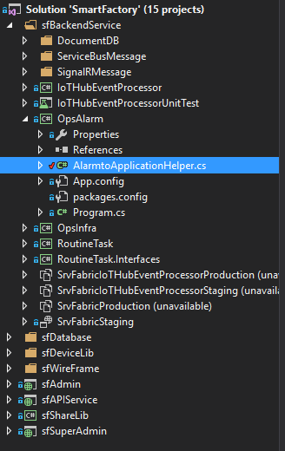
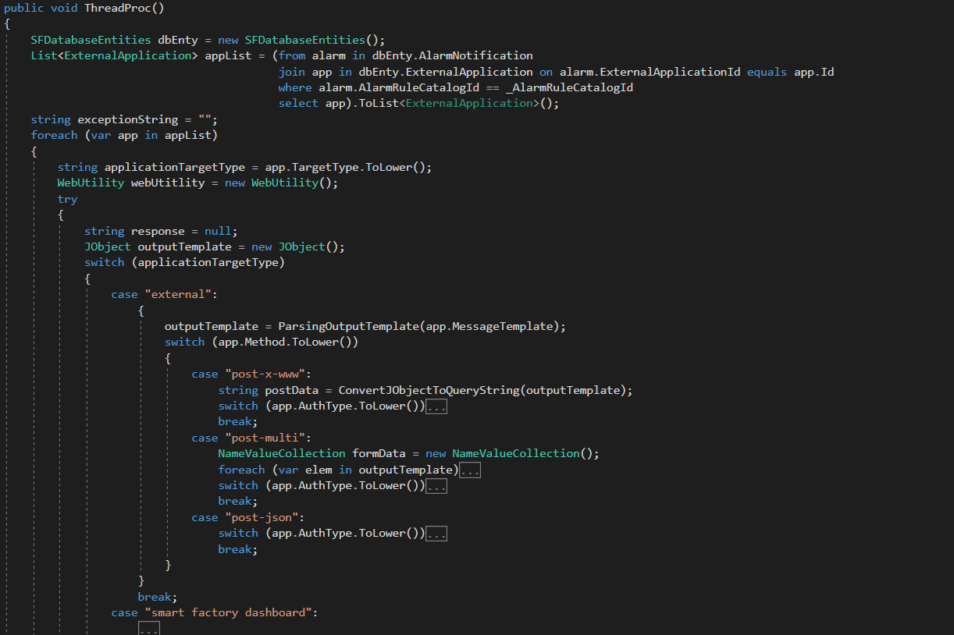
Flow

Slide 32
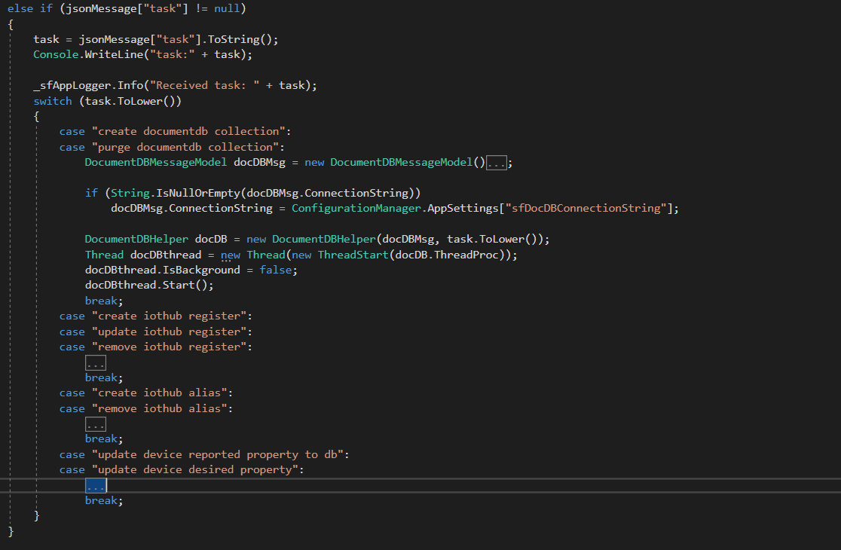
Flow
sfBackendService/OpsInfra/Program.cs (function : ListenOnServiceBusQueue)

Slide 33
Code Architecture
Service Bus
alarmops (Queue)
Infraops (Queue)
processcommand (Topic)
Listen and retrieve message
Service Fabric
OpsAlarm
OpsInfra
Event Processor Host
UsageOps
launch/remove IoTHubReceiver
create/update/remove IoTDevice settings on IoTHub
Exception
Exception, Container : log-backend-opsalarm
Share Library
DocumentDB
Helper
Log
Utility
DB
Helper
External Application
Create/remove collection and database under specific DocumentDB
Content-Type
multipart/form-data
application/x-www-form-urlencoded
application/json
Auth : Basic Auth
Admin
Entity Framework
IoT Device
IoT Hub
Document DB
Azure Storage
log-backend-opsinfra
SQL Database
External API

Slide 34
Code Architecture
Service Bus
alarmops (Queue)
Infraops (Queue)
processcommand (Topic)
Listen and retrieve message
Service Fabric
OpsAlarm
OpsInfra
Event Processor Host
UsageOps
Exception
Exception, Container : log-backend-opsalarm
Message processing
Share Library
DocumentDB
Helper
Log
Utility
DB
Helper
External Application
Content-Type
multipart/form-data
application/x-www-form-urlencoded
application/json
Auth : Basic Auth
Admin
Entity Framework
IoT Device
IoT Hub
Document DB
Azure Storage
log-backend-opsalarm
SQL Database
External API

Slide 35
Detail
OpsInfra/DocumentDBHelper.cs
Create collection with follow settings
Name : companyId
Partition Keys : /Message/equipmentId
Throughput : 400 RU/s
Indexing policy : Lazy
Create / Purge database
Name = companyId
OpsInfra/IoTHubDeviceHelper.cs
Create / Update / Remove IoTDevice in primary and secondary IoTHub
Support update IoTDevice authentication (key, x509)
OpsInfra/IoTHubEventProcessorHelper.cs
Create / Remove IoTHubEventProcessor by service fabric Rest API
Credential in Azure Storage

